Slide 1
Recap of things done
Prior to 10/10/2016

Slide 2
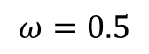
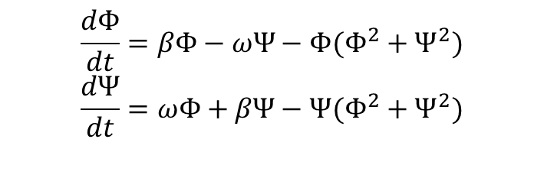
Toy Model: Simple Oscillator
We weren’t convinced we had the simplest toy model the was sinusoidal in shape
Looked to a simple oscillator:
$$\frac{dΦ}{dt}=βΦ−ωΨ−Φ(Φ^{2}+Ψ^{2})$$
$$\frac{dΨ}{dt}=ωΦ+βΨ−Ψ(Φ^{2}+Ψ^{2})$$
$$ω=0.5$$

Slide 3
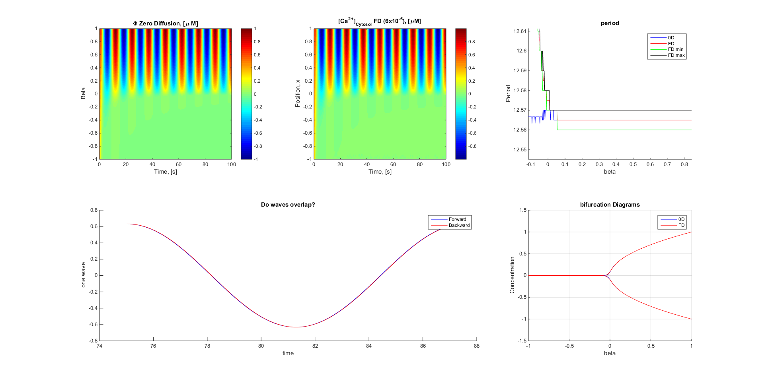
No period change in this option so no expected penetration

Slide 4
Limit cycles
 | N-E | E-S | S-W | W-N
-0.2 | 3.14 | 3.14 | 3.14 | 3.14
0.4 | 3.14 | 3.14 | 3.14 | 3.14
0.8 | 3.14 | 3.14 | 3.14 | 3.14
1 | 3.14 | 3.14 | 3.14 | 3.14

Slide 5
Plot concentration over space gif

Slide 6


Toy Model: Simple Osc + Period
Introduce Period change
$$\frac{dΦ}{dt}=βΦ−(ω+2β)Ψ−Φ(Φ^{2}+Ψ^{2})$$
$$\frac{dΨ}{dt}=(ω+2β)Φ+βΨ−Ψ(Φ^{2}+Ψ^{2})$$
$$ω=0.5$$

Slide 7
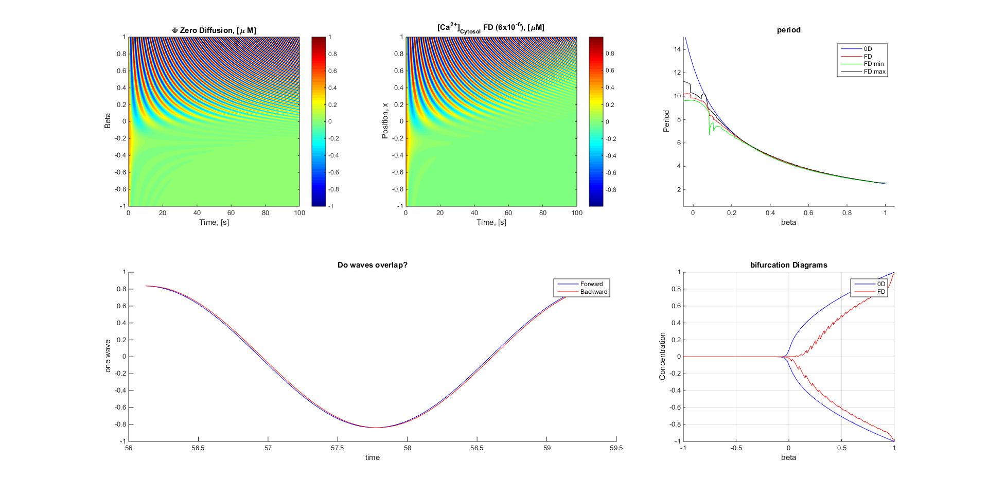
Period change in this option but symetrical so no expected penetration

Slide 8
Limit cycles
 | N-E | E-S | S-W | W-N
0.4 | 1.2 | 1.2 | 1.2 | 1.21
0.8 | 0.75 | 0.75 | 0.75 | 0.74
1 | 0.63 | 0.63 | 0.63 | 0.63

Slide 9
Plot concentration over space gif

Slide 10

Toy Model: Penetrates from poster
Period change and front heavy
$$\frac{dΦ}{dt}=βΨ−\frac{Φ^{3}}{3}+Φ$$
$$\frac{dΨ}{dt}=−\left(β Φ+α\right)+Φ$$
(mybeta = mybeta*0.4 ;
alpha = 0.2;)

Slide 11
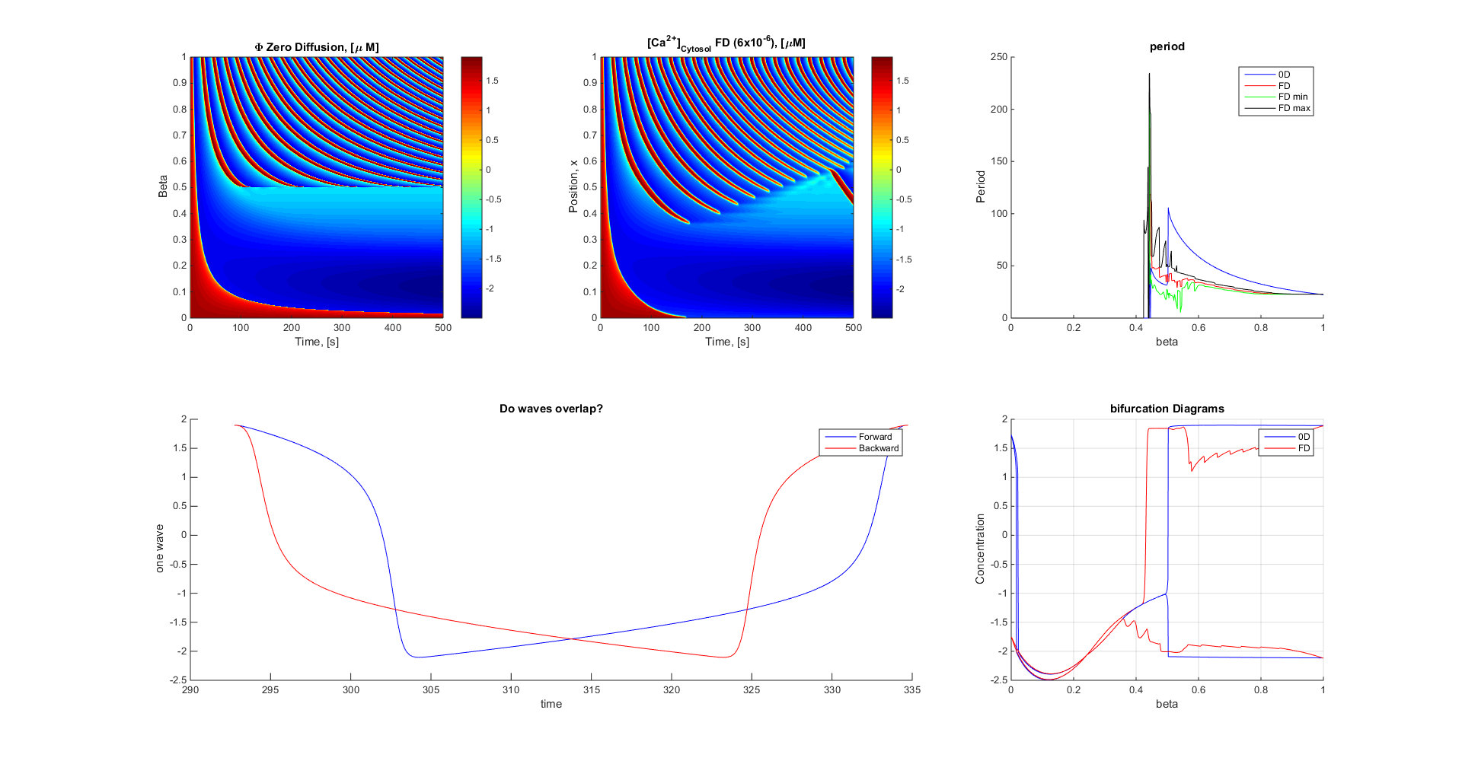

Slide 12
Limit cycles
 | N-E | E-S | S-W | W-N
0.6 | 39 | 5.88 | 11.8 | 1.8
0.8 | 19 | 3.58 | 8.14 | 1.73
1 | 11.85 | 2.83 | 6.08 | 1.62

Slide 13
Plot concentration over space gif

Slide 14
The other Week
The other week we were looking at the period inside the bifurcation phase
After talking to Tim decided to keep to the penetration region and close to the bifurcation point

